Slide 1

While Loops
An Introduction to Programming in Python
Notes:
Let's learn about While Loops.

Slide 2
Another Kind of Iteration
while condition:
pass
Notes:
FOR loops allow us to iterate through each element of a list.
They are the most common form of iteration in Python.
However, there is another kind of iteration, called While loops.

Slide 3
Syntax
While keyword
Conditional
Colon
while condition:
pass
Body
Notes:
Notice how the syntax for a WHILE loop is similar to that of an IF statement.
We have the word WHILE, followed by a condition, ending with a colon.
Then we can have any number of statements inside the body.
Remember that this body, like a FOR loop or an IF statement, is indented with 4 spaces.

Slide 4
Like IF Statements
count_down = 4
while count_down > 0:
count_down -= 1
print(count_down)
print("Reached the end")
Notes:
WHILE statements are actually very similar to IF statements.
However, instead of executing once or none, they will execute repeatedly until the condition is true.

Slide 5
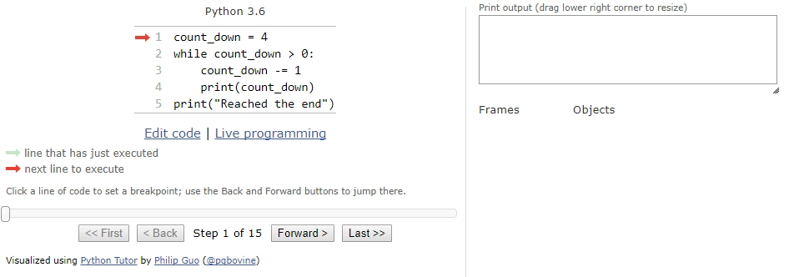
Tracing the Flow
Notes:
When a While loop is executed, the program follows a similar looping behavior as a FOR loop.
Here we can see that behavior in a WHILE loop to count down from 10.
The program tests the condition, and if it is true, then it moves through each statement in the body.
Then, it returns to the top and tests the condition again.
If it is still, true, it repeats the previous loop. Otherwise, it skips to the end of the WHILE body.

Slide 6
Looping Forever
count_down = 4
while count_down > 0:
count_down += 1
print(count_down)
print("Reached the end")
Increases the variable, so it never reaches 0!
Notes:
A tricky thing about WHILE loops is that it is easy to loop forever by accident.
Consider the code below.
Because the variable "count_down" is only ever increasing, it will never reach zero and the loop never ends.

Slide 7
While Loops Are Awful
WHILE loop
FOR loop
index = 0
while index < 10:
index += 1
print(index)
for index in range(10):
print(index)
Notes:
The FOR loop is almost always superior to the WHILE loop, because they terminate after the list is procesed; it is almost impossible to loop infinitely.
Most of the time, you should use a FOR loop instead of a WHILE loop.
As an example, consider the counting code shown before.
Instead, that can be efficiently replaced with a FOR loop that calls the "range" function, which consumes a integers and produces a list of integers counting up to that number.

Slide 8
User Input Loop
command = ""
while command != "EXIT":
command = input("Input a word, or write EXIT:")
print("You wrote", command)
print("No more words!")
Notes:
One of the very few cases for a WHILE loop is useful is dealing with repeated user input.
For instance, the Read-Evaluate-Print-Loop that powers a command line like IPython uses a While loop.
The pattern shown here is one way to handle repeated user input.
This repeatedly asks for words until the string "EXIT" is given, at which point it will exit the loop.

